Slide 1
Computer Organization Principles
School of Software, Dalian University of Technology
Chi Lin (林驰)
chilin@mail.dlut.edu.cn

Slide 2
Chapter 3 Representing & Manipulating Information
Contents
Data Representation & Encoding
Integer Representations
Integer Arithmetic
Floating Point
Arithmetic Logical Unit (ALU)

Slide 3
Today: Floating Point
Carnegie Mellon
Background: Fractional binary numbers
IEEE floating point standard: Definition
Example and properties
Rounding, Addition, Multiplication
Floating point in C
Summary

Slide 4
Today: Floating Point
Carnegie Mellon
Background: Fractional binary numbers
IEEE floating point standard: Definition
Example and properties
Rounding, addition, multiplication
Floating point in C
Summary

Slide 5
Decimal Notations
Decimal notation uses a representation of the form d_{m}d_{m−1} . . . d₁d₀.d₋₁d₋₂ . . . d_{−n}, where each decimal digit d_{i} ranges between 0 and 9. This notation represents a value d defined as
E.g. 123.4567

Slide 6
Binary Notation
By analogy, consider a notation of the form b_{m}b_{m−1} . . .b₁b₀.b₋₁b₋₂ . . .b_{−n−1}b_{−n}, where each binary digit, or bit, b_{i} ranges between 0 and 1.
This notation represents a number b defined as:
Binary Point
Left: Positive powers of 2
Right: Negative powers of 2

Slide 7
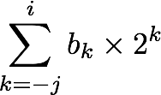
Fractional Binary Numbers
2^{i}
2^{i-1}
4
2
1
• • •
bi | bi-1 | ••• | b2 | b1 | b0 | b-1 | b-2 | b-3 | ••• | b-j
1/2
1/4
1/8
2^{-j}
• • •
Representation
Bits to right of “binary point (二进制小数点)” represent fractional powers of 2
Represents rational number:
Notes:
Latex source for equation: \sum_{k=-j}^i b_k \times 2^k

Slide 8
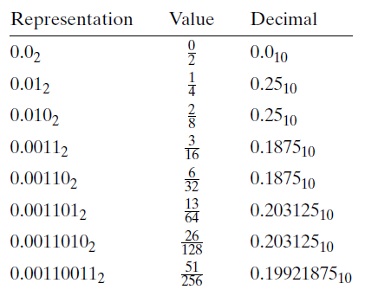
Fractional Binary Numbers: Examples
Carnegie Mellon
Value Representation
5 3/4 101.112
2 7/8 10.1112
63/64 0.1111112
Observations
Divide by 2 by shifting right
Multiply by 2 by shifting left
Numbers of form 0.111111…2 are just below 1.0
1/2 + 1/4 + 1/8 + … + 1/2^{i} + … ➙ 1.0
Use notation 1.0 – ε

Slide 9
Representable Numbers
Carnegie Mellon
Limitation
Can only exactly represent numbers of the form x*2^{k}
Other rational numbers have repeating bit representations
Value Representation
1/3 0.0101010101[01]…2
1/5 0.001100110011[0011]…2
1/10 0.0001100110011[0011]…2

Slide 10
How to express Fractional Binary Numbers
E.g. 0.625
0. 625 * 2
1. 25 * 2
0. 5 * 2
1
0.625₁₀=0.101₂
E.g. 0.1
0. 1 * 2
0. 2 * 2
0. 4 * 2
0. 8 * 2
1. 6 * 2
0. 2 * 2
….
0.1₁₀=0.000[100]₂

Slide 11
Today: Floating Point
Carnegie Mellon
Background: Fractional binary numbers
IEEE floating point standard: Definition
Example and properties
Rounding, addition, multiplication
Floating point in C
Summary

Slide 12
IEEE Floating Point
Carnegie Mellon
IEEE Standard 754
Established in 1985 as uniform standard for floating point arithmetic
Before that, many idiosyncratic formats
Supported by all major CPUs
Driven by numerical concerns
Nice standards for rounding, overflow, underflow
Hard to make fast in hardware
Numerical analysts predominated over hardware designers in defining standard

Slide 13
Floating Point Representation
Carnegie Mellon
Just store S, M and E as the floating point representation ???
The answer is no!
Numerical Form:
Sign bit (符号位) s determines whether number is negative or positive
Significand (尾数) M normally a fractional value in range [1.0,2.0).
Exponent (阶码) E weights value by power of two

Slide 14
Floating Point Representation
Floating Point Encoding
MSB s is sign bit s
exp field encodes E (but is not equal to E)
frac field encodes M (but is not equal to M)
s | exp | frac

Slide 15
Precisions
Carnegie Mellon
Single precision: 32 bits
Double precision: 64 bits
s | exp | frac
1 | 8-bits | 23-bits
s | exp | frac
1 | 11-bits | 52-bits

Slide 16
Three categories of floating points
Normalized
Denormalized
Special Values

Slide 17
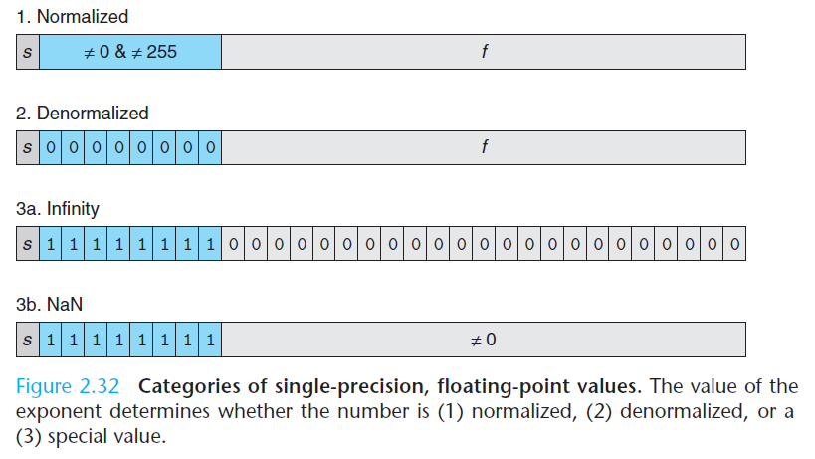
Normalized, Denormalized, Special Values

Slide 18
Normalized Values（规格化数据）
Condition: exp ≠ 000…0 and exp ≠ 111…1
Exponent coded as biased (偏置) value: E = Exp – Bias
Exp: unsigned value exp
Bias = 2^{k-1} - 1, where k is number of exponent bits
Single precision: 127 (Exp: 1…254, E: -126…127)
Double precision: 1023 (Exp: 1…2046, E: -1022…1023)

Slide 19
Normalized Values
Significand coded with implied leading 1: M = 1.xxx…x2
.xxx…x: bits of frac
Minimum when 000…0 (M = 1.0)
Maximum when 111…1 (M = 2.0 – ε)
Get extra leading bit for “free”

Slide 20
Normalized Encoding Example
Value: Float F = 15213.0;
15213₁₀ = 11101101101101₂
= 1.1101101101101₂ x 2¹³
Significand
M = 1.1101101101101₂
frac = 11011011011010000000000₂
Exponent
E = 13
Bias = 127
Exp = 13+127 = 140 = 10001100₂
Result: 0 10001100 11011011011010000000000
s
exp
frac

Slide 21
Denormalized Values
Carnegie Mellon
Condition: exp = 000…0
Exponent value: E = –Bias + 1 (instead of E = 0 – Bias) (For seamless)
Significand coded with implied leading 0: M = 0.xxx…x2
xxx…x: bits of frac

Slide 22
Denormalized Values
Cases
exp = 000…0, frac = 000…0
Represents zero value
Note distinct values: +0 and –0 (why?)
exp = 000…0, frac ≠ 000…0
Numbers very close to 0.0
Lose precision as get smaller

Slide 23
Special Values
Carnegie Mellon
Condition: exp = 111…1
Case: exp = 111…1, frac = 000…0
Represents value ∞ (infinity)
S>0, +∞ S<0, - ∞
Operation that overflows
Both positive and negative
E.g., 1.0/0.0 = −1.0/−0.0 = +∞, 1.0/−0.0 = −∞

Slide 24
Special Values
Case: exp = 111…1, frac ≠ 000…0
Not-a-Number (NaN)
Represents case when no numeric value can be determined
E.g., sqrt(–1), ∞ − ∞, ∞ × 0

Slide 25
Visualization: Floating Point Encodings
Carnegie Mellon
−∞
+∞
−Normalized
−Denorm
+Denorm
+Normalized
NaN
NaN
−0
+0

Slide 26
Today: Floating Point
Carnegie Mellon
Background: Fractional binary numbers
IEEE floating point standard: Definition
Example and properties
Rounding, addition, multiplication
Floating point in C
Summary

Slide 27
Tiny Floating Point Example
Carnegie Mellon
s | exp | frac
1 | 4-bits | 3-bits
8-bit Floating Point Representation
the sign bit is in the most significant bit
the next four bits are the exponent, with a bias of 7
the last three bits are the frac
Same general form as IEEE Format
normalized, denormalized
representation of 0, NaN, infinity

Slide 28
Dynamic Range (Positive Only)
Carnegie Mellon
s exp frac E Value
0 0000 000 -6 0
0 0000 001 -6 1/8*1/64 = 1/512
0 0000 010 -6 2/8*1/64 = 2/512
…
0 0000 110 -6 6/8*1/64 = 6/512
0 0000 111 -6 7/8*1/64 = 7/512
0 0001 000 -6 8/8*1/64 = 8/512
0 0001 001 -6 9/8*1/64 = 9/512
…
0 0110 110 -1 14/8*1/2 = 14/16
0 0110 111 -1 15/8*1/2 = 15/16
0 0111 000 0 8/8*1 = 1
0 0111 001 0 9/8*1 = 9/8
0 0111 010 0 10/8*1 = 10/8
…
0 1110 110 7 14/8*128 = 224
0 1110 111 7 15/8*128 = 240
0 1111 000 n/a inf
closest to zero
Denormalized
numbers
largest denorm
smallest norm
closest to 1 below
Normalized
numbers
closest to 1 above
largest norm

Slide 29
Distribution of Values
Carnegie Mellon
6-bit IEEE-like format
e = 3 exponent bits
f = 2 fraction bits
Bias is 2³⁻¹-1 = 3
Notice how the distribution gets denser toward zero.
s | exp | frac
1 | 3-bits | 2-bits

Slide 30
Distribution of Values (close-up view)
Carnegie Mellon
6-bit IEEE-like format
e = 3 exponent bits
f = 2 fraction bits
Bias is 3
s | exp | frac
1 | 3-bits | 2-bits

Slide 31
Interesting Numbers
Carnegie Mellon
{single,double}
Description exp frac Numeric Value
Zero 00…00 00…00 0.0
Smallest Pos. Denorm. 00…00 00…01 2^{– {23,52}} x 2^{– {126,1022}}
Single ≈ 1.4 x 10^{–45}
Double ≈ 4.9 x 10^{–324}
Largest Denormalized 00…00 11…11 (1.0 – ε) x 2^{– {126,1022}}
Single ≈ 1.18 x 10^{–38}
Double ≈ 2.2 x 10^{–308}
Smallest Pos. Normalized 00…01 00…00 1.0 x 2^{– {126,1022}}
Just larger than largest denormalized
One 01…11 00…00 1.0
Largest Normalized 11…10 11…11 (2.0 – ε) x 2^{{127,1023}}
Single ≈ 3.4 x 10³⁸
Double ≈ 1.8 x 10³⁰⁸

Slide 32
Today: Floating Point
Carnegie Mellon
Background: Fractional binary numbers
IEEE floating point standard: Definition
Example and properties
Rounding, addition, multiplication
Floating point in C
Summary

Slide 33
FP Multiplication
Carnegie Mellon
(–1)^{s1}*M1*2^{E1} * (–1)^{s2} *M2*2^{E2}
Exact Result: (–1)^{s}*M*2E
Sign s: s1 ^ s2
Significand M: M1 * M2
Exponent E: E1 + E2
Fixing
If M ≥ 2, shift M right, increment E
If E out of range, overflow
Round M to fit frac precision

Slide 34
Floating Point Addition
Carnegie Mellon
(–1)^{s1} M1 2^{E1} + (-1)^{s2} M2 2^{E2}
Assume E1 > E2
Exact Result: (–1)^{s} M 2E
Sign s, significand M:
Result of signed align & add
Exponent E: E1
Fixing
If M ≥ 2, shift M right, increment E
if M < 1, shift M left k positions, decrement E by k
Overflow if E out of range
E1–E2
(–1)^{s1} M1
+
(–1)^{s2} M2
(–1)^{s} M

Slide 35
Mathematical Properties of FP Add
Carnegie Mellon
Compare to those of Abelian Group
Closed under addition?
But may generate infinity or NaN
Commutative?
Associative?
Overflow and inexactness of rounding
0 is additive identity?
Every element has additive inverse
Except for infinities & NaNs
Monotonicity
a ≥ b ⇒ a+c ≥ b+c?
Except for infinities & NaNs
Yes
Yes
No
Yes
Almost
Almost

Slide 36
Mathematical Properties of FP Mult
Carnegie Mellon
Compare to Commutative Ring
Closed under multiplication?
But may generate infinity or NaN
Multiplication Commutative?
Multiplication is Associative?
Possibility of overflow, inexactness of rounding
1 is multiplicative identity?
Multiplication distributes over addition?
Possibility of overflow, inexactness of rounding
Monotonicity
a ≥ b & c ≥ 0 ⇒ a * c ≥ b *c?
Except for infinities & NaNs
Yes
Yes
No
Yes
No
Almost

Slide 37
Today: Floating Point
Carnegie Mellon
Background: Fractional binary numbers
IEEE floating point standard: Definition
Example and properties
Rounding, addition, multiplication
Floating point in C
Summary

Slide 38
Floating Point in C
Carnegie Mellon
C Guarantees Two Levels
float single precision
double double precision
Conversions/Casting
Casting between int, float, and double changes bit representation
double/float → int
Truncates fractional part
Like rounding toward zero
Not defined when out of range or NaN: Generally sets to TMin
int → double
Exact conversion, as long as int has ≤ 53 bit word size
int → float
Will round according to rounding mode

Slide 39
Examples Addition
(3.14+1e10)-1e10 evaluates to 0.0
3.14+(1e10-1e10) evaluates to 3.14

Slide 40
Examples Mult
Not associative
(1e20*1e20)*1e-20 evaluates to +∞
1e20*(1e20*1e-20) evaluates to 1e20.
Not distribute over addition.
1e20*(1e20-1e20) evaluates to 0.0
1e20*1e20-1e20*1e20 evaluates to NaN.

Slide 41
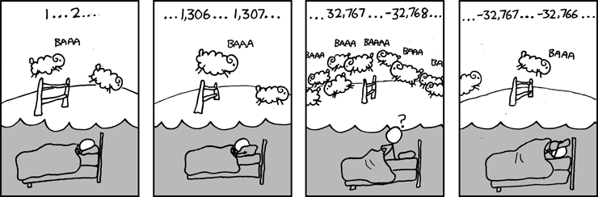
Aha Gocha
Carnegie Mellon
Example 1: Is x² ≥ 0?
Float’s: Yes!
Int’s:
40000 * 40000 = 1600000000
50000 * 50000 = ??
Example 2: Is (x + y) + z = x + (y + z)?
Unsigned & Signed Int’s: Yes!
Float’s:
(1e20 + -1e20) + 3.14 --> 3.14
1e20 + (-1e20 + 3.14) --> ??

Slide 42
Homework
Review Chapter 2
Preview Chapter 3.1
Practice Problem 2.45
Practice Problem 2.47

Slide 43
Thank You

